Slide 1

.NET Fundamentals with C#
Lesson 5

Slide 2
Lesson Summary
Generics
Arrays & Collections
Indexers
Iteration
Iterator State Machines & Deferred Execution
Keywords

Slide 3
Generics
Introduces type parameters to allow types to defer specification of one or more types until the generic type is declared and instantiated by client code
Maximizes code reuse, type safety and performance
Most commonly used to create collection classes
IEnumerable<T>, ICollection<T>, List<T>, Dictionary<TKey, TValue>
Can be used to amplify other types with additional functionality
Nullable<T>, Task<T>, EventHandler<TEventArgs>

Slide 4
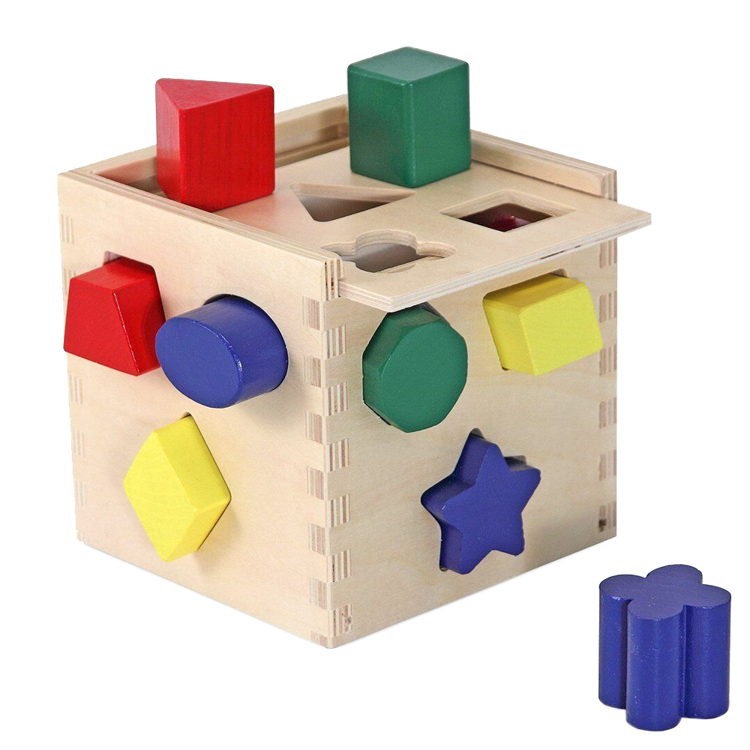
Generics
Think of this toy as a generic type called Toy<T> where T represents a shape. Toy<T> is implemented to take any shape. Now imagine this box has the ability to change all of the entry points to the box into a particular shape. When we declare Toy<Star>, all of the entry points to the box become Star shaped.

Slide 5
Generics
public class StringList
{
public void Set(int index, string value) { … }
public string Get(int index) { … }
}
StringList list = new StringList();
public class ColorList
{
public void Set(int index, Color value) { … }
public Color Get(int index) { … }
}
ColorList list = new ColorList();

Slide 6
Generics
public class List<T>
{
public void Set(int index, T value) { … }
public T Get(int index) { … }
}
List<string> list = new List<string>();
List<Color> list = new List<Color>();

Slide 7
Arrays & Collections
Arrays are fixed length, indexable, type safe, and can be single-dimensional, multi-dimensional, or jagged
Value type arrays store the values themselves in a contiguous block of heap memory
Reference type arrays store the references to reference type instances in a contiguous block of heap memory. The reference type instances are stored randomly in heap memory
Arrays are zero indexed

Slide 8
Arrays & Collections
A single-dimensional int array with 10 items
int[] numbers = new int[10];
numbers[0] = 55;
A two-dimensional int array with 4*2 items
int[,] numbersOfNumbers = new int[4, 2];
numbersOfNumbers[i, j] = 7;
A three-dimensional int array with 7*5*3 items
int[,,] numbersOfNumbersOfNumbers = new int[7, 5, 3];
numbersOfNumbersOfNumbers[23, i, j] = 99;

Slide 9
Arrays & Collections
A jagged array
int[][] jaggedNumbers = new int[3][];
jaggedNumbers[0] = new int[10];
jaggedNumbers[1] = new int[5];
jaggedNumbers[2] = new int[123];
Array initialization
int[] numbers = new int[] { 34, 45, 56, 67 };
string[] words = new string[] { "Hello", "World" };

Slide 10
Arrays & Collections
The .NET Framework provides many different collection types
Before .NET 2.0 collection types were non-generic
Collection types are located in the System.Collections namespace
IEnumerable, ICollection, IDictionary, IList, …
ArrayList, Hashtable, SortedList, Stack, …
From .NET 2.0 onwards, collection types included generics
Generic collection types are located in the System.Collections.Generic namespace
IEnumerable<T>, ICollection<T>, IDictionary<TKey, TValue>, IList<T>, …
List<T>, Dictionary<TKey, TValue>, HashSet<T>, LinkedList<T>, …

Slide 11
Indexers
Provide semantics for classes or structs to be indexed like an array or dictionary
Implemented as a special case property
Indexers cannot be implemented with an auto-implementation
public class List<T>
{
public List(params T[] items) { … }
public T this[int index]
{
get { return someCollection.Get(index); }
set { someCollection.Set(index, value); }
}
}
List<string> list = new List<string>("Apple", "Banana", "Cherry", "Damson");
Console.WriteLine(list[1]);

Slide 12
Iteration
The ability to iterate (or loop) over an array or collection
All conditional loop statements can be used to iterate over an array or collection
A foreach loop is specifically designed for iteration over an array or collection type that implements IEnumerable or IEnumerable<T>
Most common collection types in .NET implement IEnumerable<T>
Another way to perform iteration is to use recursion, where a method calls itself until a condition is met
Attempting infinite recursion will result in a StackOverflowException

Slide 13
Iteration
Using a for loop
string[] fruits = new string[] { "Apple", "Banana", "Cherry", "Damson" };
for (int i = 0; i < numbers.Length; i++)
{
Console.WriteLine(fruits[i]);
}
Using a foreach loop
IEnumerable<int> numbers = new int[] { 12, 23, 34, 45, 56 };
foreach (int number in numbers)
{
int square = number * number;
Console.WriteLine(square);
}

Slide 14
Iteration
Using a while loop
LinkedList<int> numbers = LinkedList<int>(new[] { 1, 2, 3 });
LinkedListNode<int> node = numbers.First;
while (node != null)
{
Console.WriteLine(node.Value);
node = node.Next;
}
Using recursion
public void EnumerateDirectories(string directory)
{
foreach(string dir in Directory.GetDirectories(directory))
{
Console.WriteLine(dir);
EnumerateDirectories(dir);
}
}

Slide 15
Iterator State Machines & Deferred Execution
Iterator state machines are implemented using the yield keyword which indicates that a method, operator or get accessor is an iterator
Iterator state machines are implemented by the CLR and remove the need for explicit implementations to maintain the state of an enumeration
Execution of iterator state machines is deferred until the state is enumerated
Iterator blocks must return iterator interface types, for example IEnumerable<T>
public IEnumerable<int> GetSquares(int from, int to)
{
for (int i = from; i <= to; i++)
{
yield return i * i;
}
}

Slide 16
Keywords
for – a loop for iterating over a code block for a set number of times
foreach – a loop for iterating over enumerable types
while – a loop for iterating until a condition is met
yield – creates an iterator state machine and defers execution of enumeration
params – allows an array parameter to take a variable number of arguments

